Slide 1

Bayesian Inference:
Posterior = Likelihood × Prior ÷ Evidence

Slide 2
Framework of Bayesian inference
I have a belief (prior)
  I am probably allergic to cats
Something happens (event/evidence)
  Cat walks into room and I sneeze/do not sneeze
How do I revise my belief, considering the event (posterior)?
  If I sneezed, my belief should be strengthened
  If I did not sneeze, my belief should be weakened
Two key concepts from probability theory
  Joint probability: P(A∧B) probability that A and B occur together
  Conditional probability: P(A|B) probability that A occurs, given that B has occurred
event
prior
posterior
x
Beliefs modeled as distributions

Slide 3
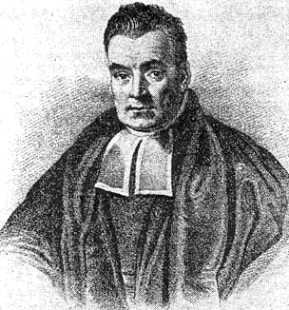
Organization
Basic concepts in probability
Sample space and events
Joint probability and marginalization
Conditional probability
Bayes’ rule: prior → posterior
Applications
Naïve Bayes classifier
Maximum a Posteriori Estimator (MAP)
Bayesian networks
Rev. Thomas Bayes (1701-1761)

Slide 4
Basic probability: sample space and events
Experiment: I throw a fair die.
Sample space: set of possible outcomes of experiment
Example: {1,2,3,4,5,6}
Realization: element of sample space
Example: 5
Event: subset of sample space, possibly empty
Intuitively, some characteristic (feature) of realizations
Example:
  Prime = {2,3,5}
  Even = {2,4,6}
  Two = {2}
Simple event: singleton set (exactly one sample element)
Compound element: set with multiple elements of sample space
Distinction between realization and event is very important
4 6
prime
2
1 3 5
Sample space

Slide 5
ML interpretation
Sample space:
spam detection: set of messages
Realization: one element from sample space
Events:
Binary features: spam, ¬ spam
Categorical features: cuisines {American, Chinese, Japanese}
Numerical features: height, weight
¬ spam
spam
Sample space: messages

Slide 6
Joint Probability

Slide 7
Joint probability
Question:
I throw a fair die. What is the probability of obtaining a number that is odd and prime?
Write as P(odd ∧ prime)
Answer:
Sample space = {1,2,3,4,5,6}.
3 and 5 only numbers both odd and prime, so
probability = 1/3
Can we compute this probability from probability of “odd” and probability of “prime”? In general, no.
P(odd) = 1/2
P(prime) = 1/3
Incorrect answer: P(odd ∧ prime) = P(odd)*P(prime) = 1/6
4 6
2
odd
1 3 5
prime
Sample space = {1,2,3,4,5,6}
A & B are events
Samples(A∧B) = Samples(A) ∩ Samples(B)
but in general,
P(A∧B) ≠ P(A)*P(B)
Venn diagram can be misleading!

Slide 8
Joint probability matrix representation
Matrix representation of joint probability of events:
rows and columns are events, entries are probabilities
In our example, binary events (features) so a 2x2 matrix
Fill in matrix by assigning each sample to one matrix entry and then dividing the number of samples in each entry by the total number of samples
4 6
2
odd
1 3 5
prime
prime
¬ prime
odd
{3,5}
{1}
2/6
1/6
{2}
{4,6}
¬odd
1/6
2/6

Slide 9
Marginalization
Marginalization: probability of event such as odd or
¬ prime is obtained by computing row or column sums.
No need to enumerate events.
We can go from joint probability to individual event probabilities but in general, not the other way around.
Knowing P(A) and P(B) gives you row and column sums
in the 2x2 matrix, but this does not determine the matrix entries uniquely so in general P(A∧B) ≠ P(A)*P(B)
4 6
2
odd
1 3 5
prime
prime
¬ prime
odd
{3,5}
{1}
3/6
2/6
1/6
{2}
{4,6}
3/6
¬odd
1/6
2/6
3/6
3/6

Slide 10
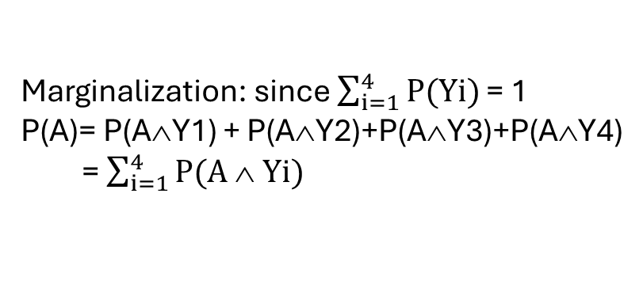
Generalization (I): categorical events/features
Years in school
Grade
Yrs
Y1
Y2
Y3
Y4
S1
A
3
A
0.12
0.08
0.13
0.03
0.36
S2
B
2
…
…
…
…
B
S3
A
3
Raw data
Grade
C
…
…
…
…
…
…
…
…
…
…
D
…
…
…
…
…
…
In my class, I have 120 students. Each one has 1,2,3 or 4 years of school, and their grade is A,B,C or D. What is joint probability of grades and years of school?
Construction: enumerate sample space & count # of samples in each matrix entry; divide by sample size.
Joint probability matrix
Marginalization: since $\sum_{i=1}^{4}{P(Yi)}$ = 1
P(A)= P(A∧Y1) + P(A∧Y2)+P(A∧Y3)+P(A∧Y4)
= $\sum_{i=1}^{4}{P(A ∧ Yi)}$
Generalization: joint probability tensor for
3 or more features

Slide 11
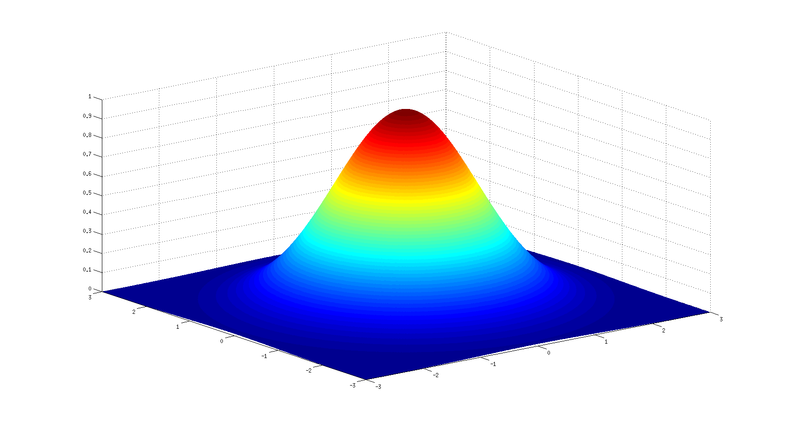
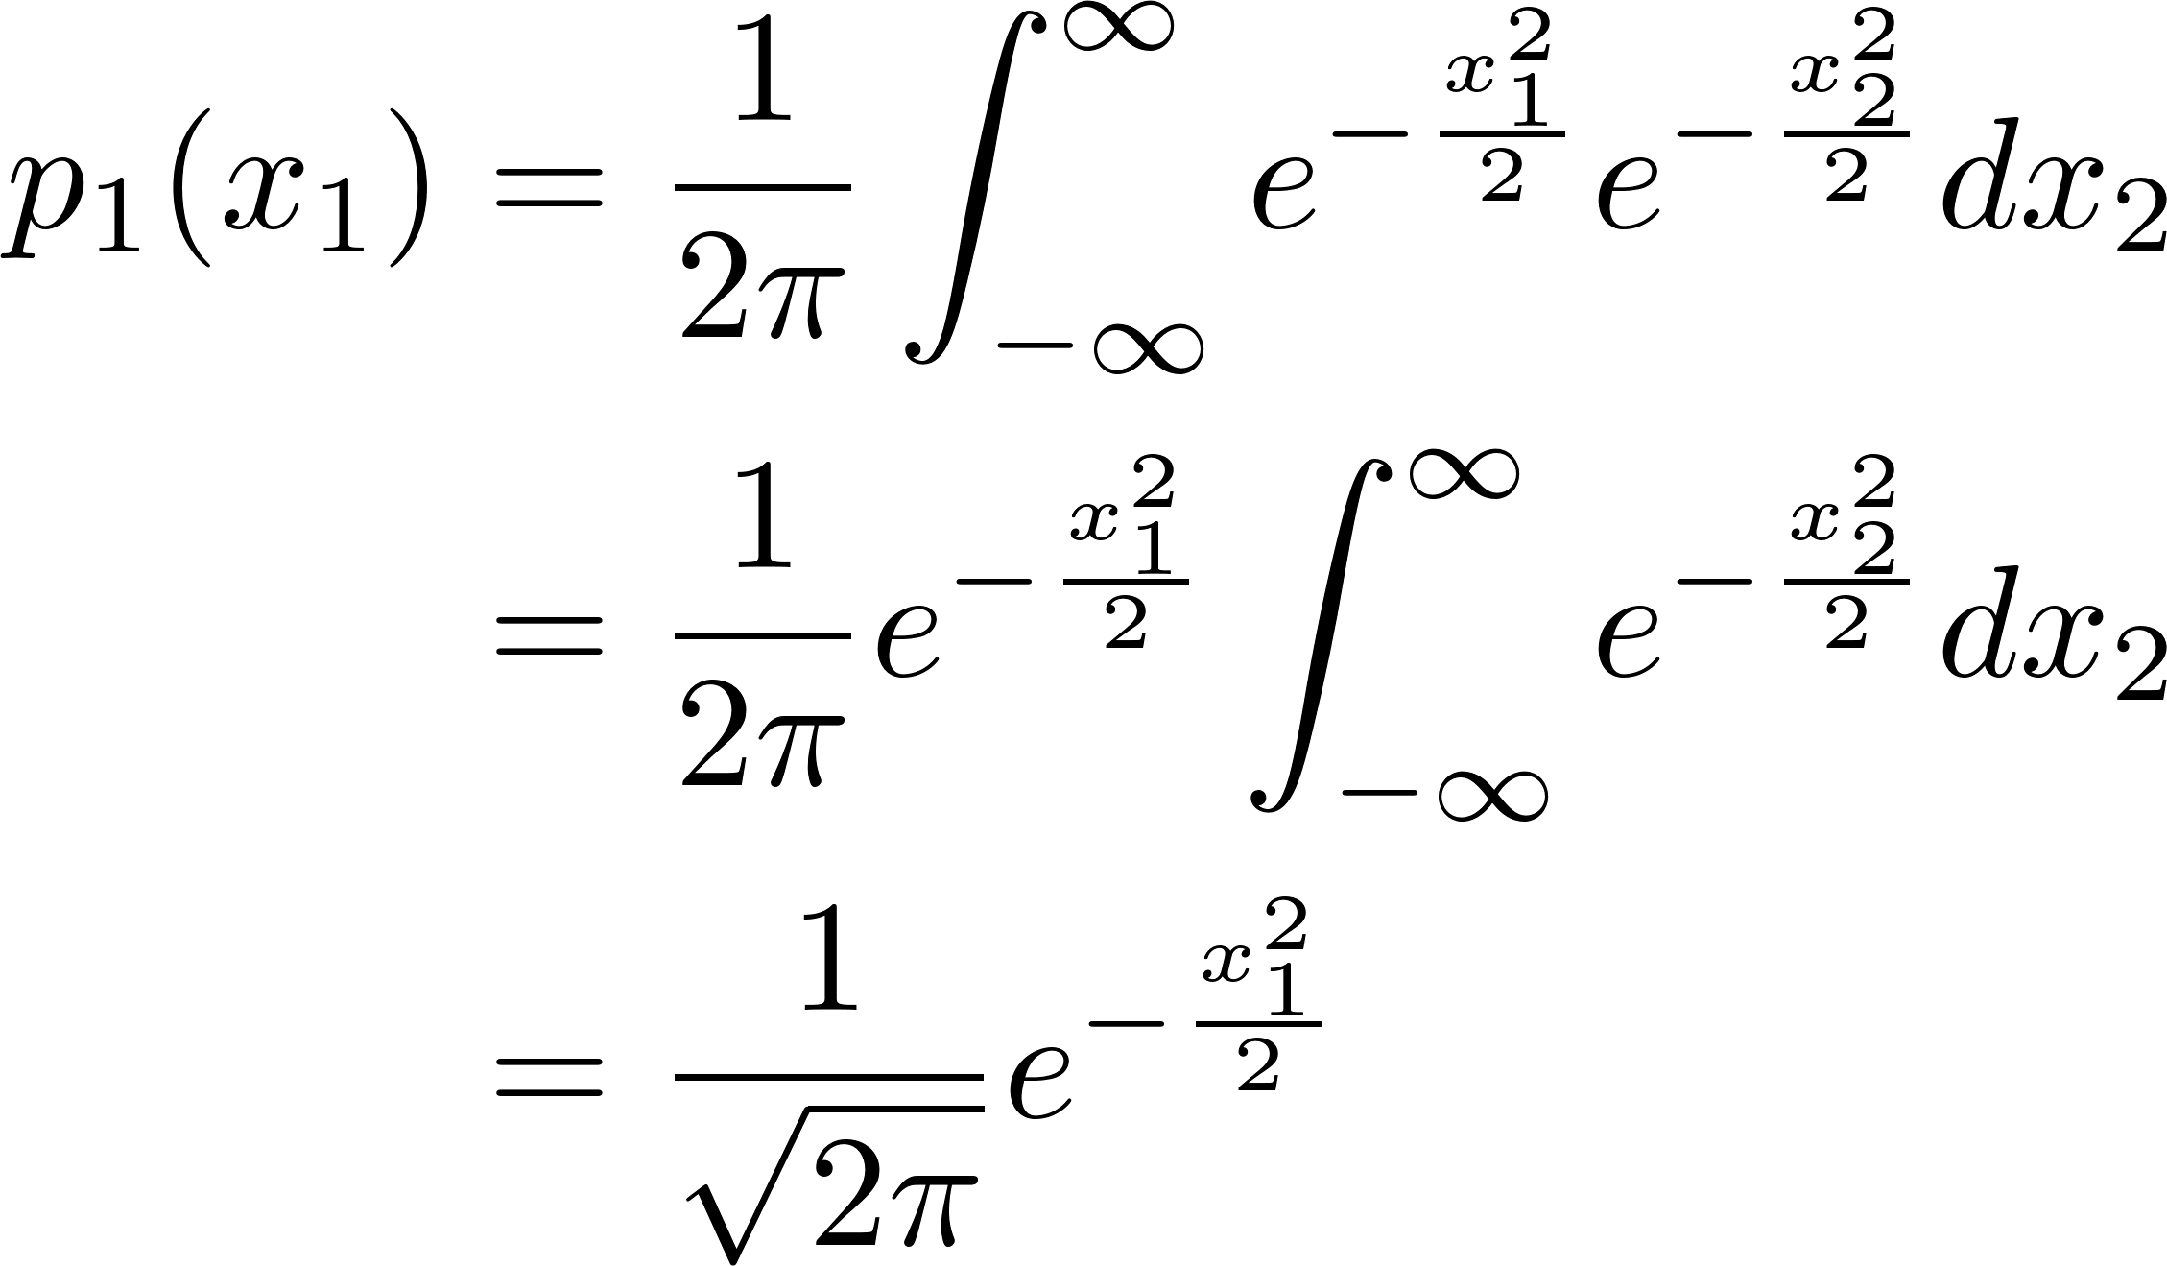
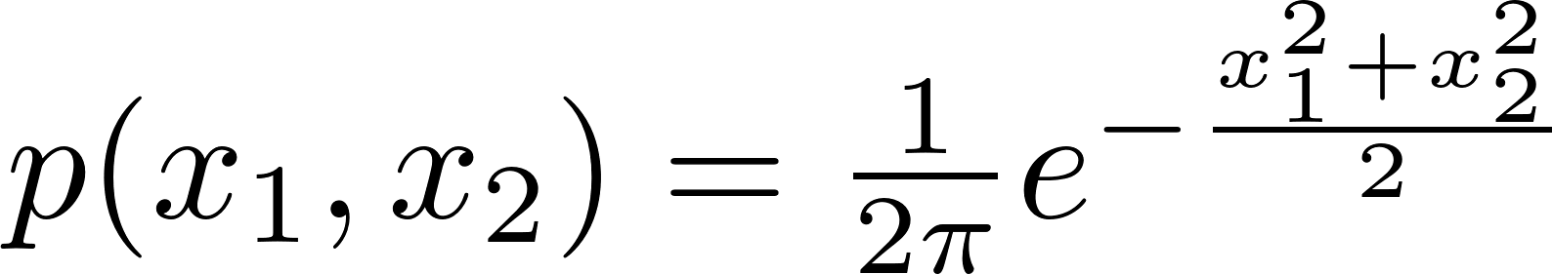
Generalization (II): numerical/continuous events/features
Numerical/continuous events: intuitively,
“infinite” number of rows and columns
Probability → probability density function (pdf)
Marginalization: integration
p(x₁,x₂)
x₂
x₁
2-D Gaussian with mean (0,0)

Slide 12
Conditional Probability

Slide 13
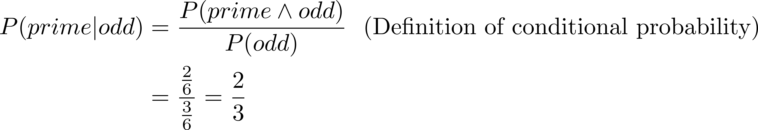
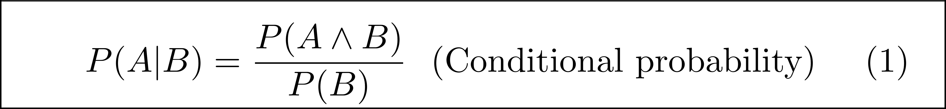
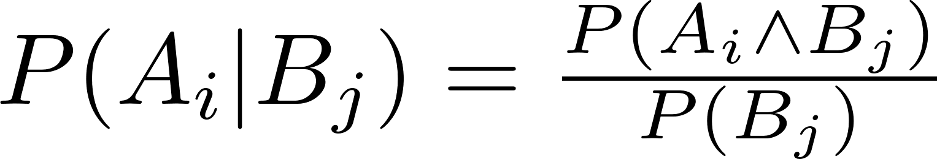
Conditional probability
⇓
What is the probability that the number on the die is prime, given that it is odd?
Ans: Possible outcomes for odd are {1,3,5}.
{3,5} are prime so probability is 2/3.
Can we calculate this from joint probability table without knowing sample space?
Ans:
⇓
prime
¬ prime
odd
{3,5}
{1}
3/6
2/6
1/6
{2}
{4,6}
3/6
¬odd
1/6
3/6
3/6
3/6
Intuitively, conditional probability
(i) selects a row or column
(ii) normalizes the probabilities in that
row or column by the row/column sum
Categorical events/features:

Slide 14
Independence
Events A and B are independent if P(A|B) = P(A)
Intuitively, knowing that B has occurred does not change the probability of event A
Equivalently,
P(A ∧ B) = P(A|B) * P(B) = P(A) * P(B)
Example: toss of die
E1: ≤ 3
E2: {2,4}
P(E2|E1) = 1/3 = P(E2)
⇓
⇓
E2
¬ E2
E1
{2}
{1,3}
1/6
2/6
3/6
{ 4}
{5,6}
¬E1
1/6
2/6
3/6
2/6
4/6

Slide 15
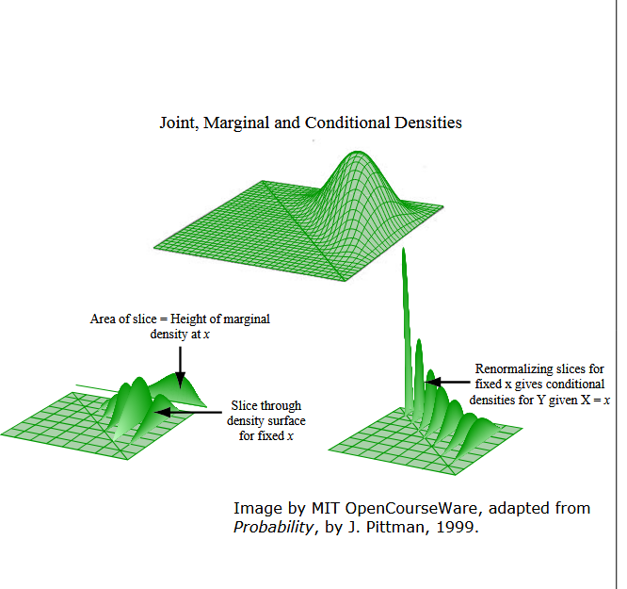
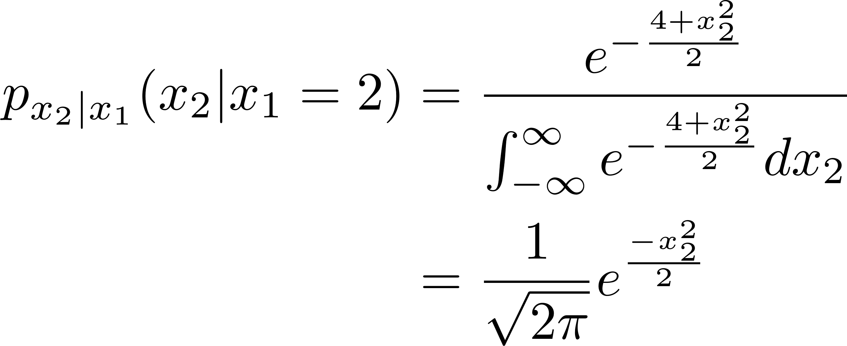
Conditional probability for continuous events/features
2-D Gaussian with mean (0,0) and covariance = I
Conditional pdf for x₁ = 2
x₂
x₁
This makes sense since x₁ and x₂ are independent.

Slide 16
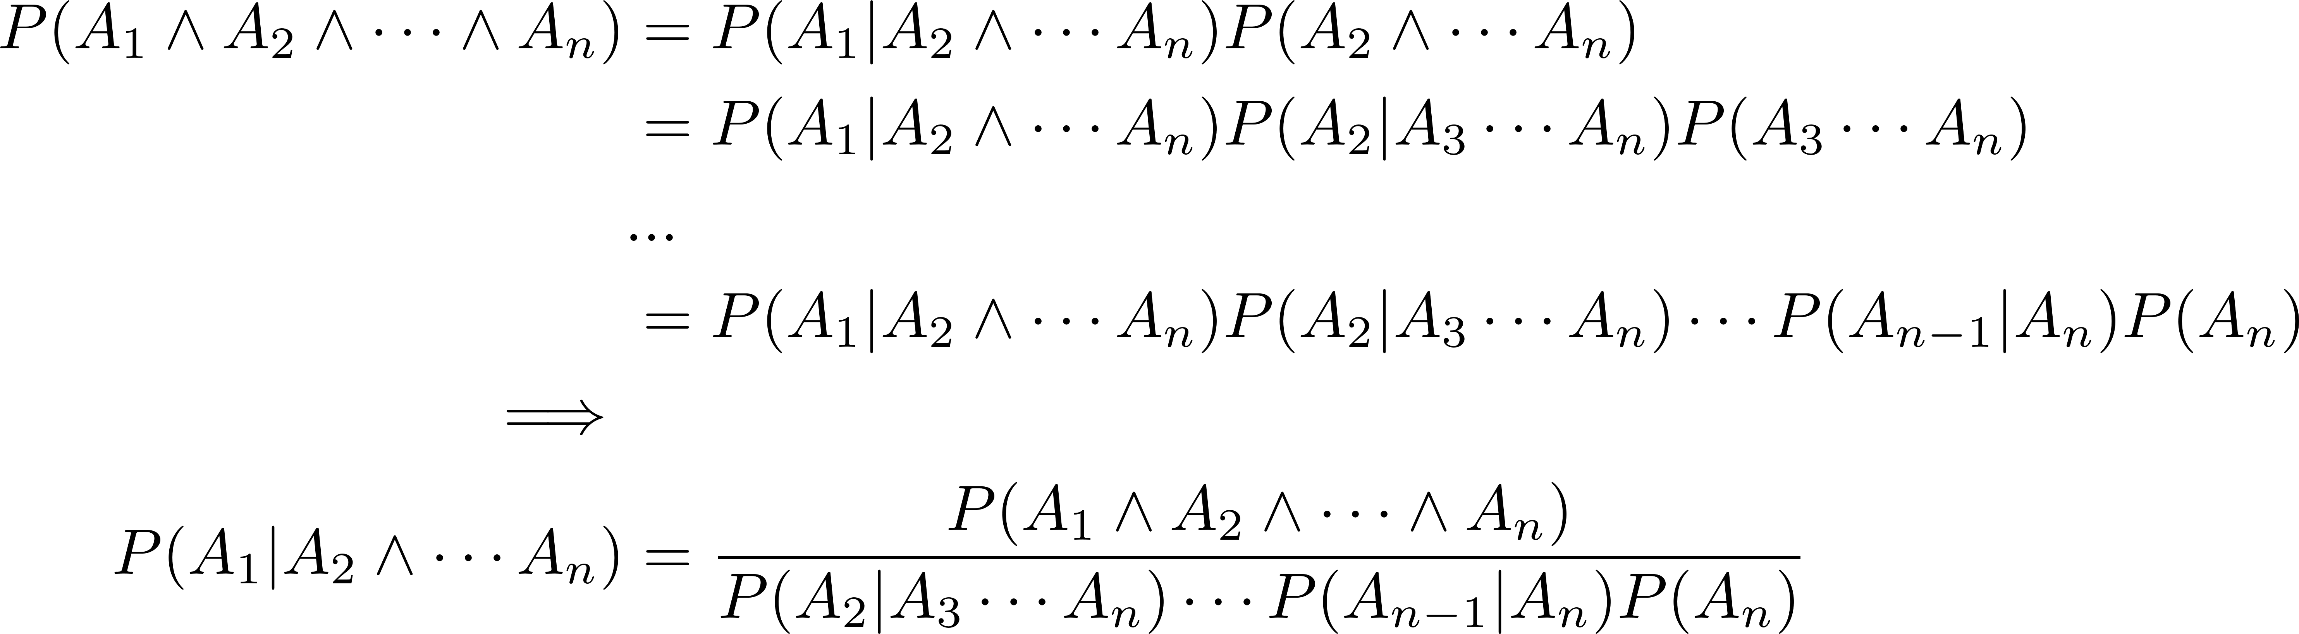
Chain rule: conditioning on multiple events
Chain rule for conditional probability: prove by induction
Variable order is arbitrary but usually, A₁ is outcome and A₂..A_{n} are events that may affect A₁.

Slide 17
Bayes’ Rule

Slide 18
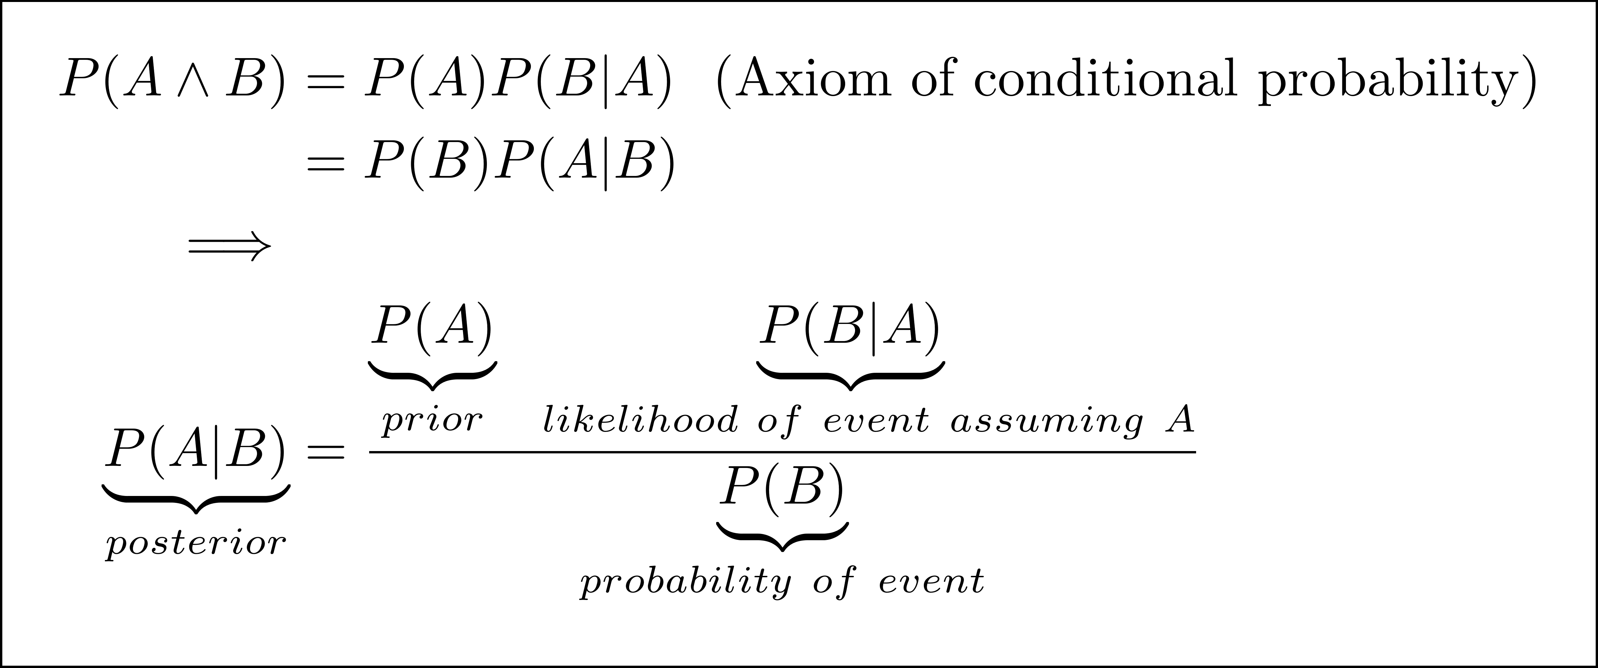
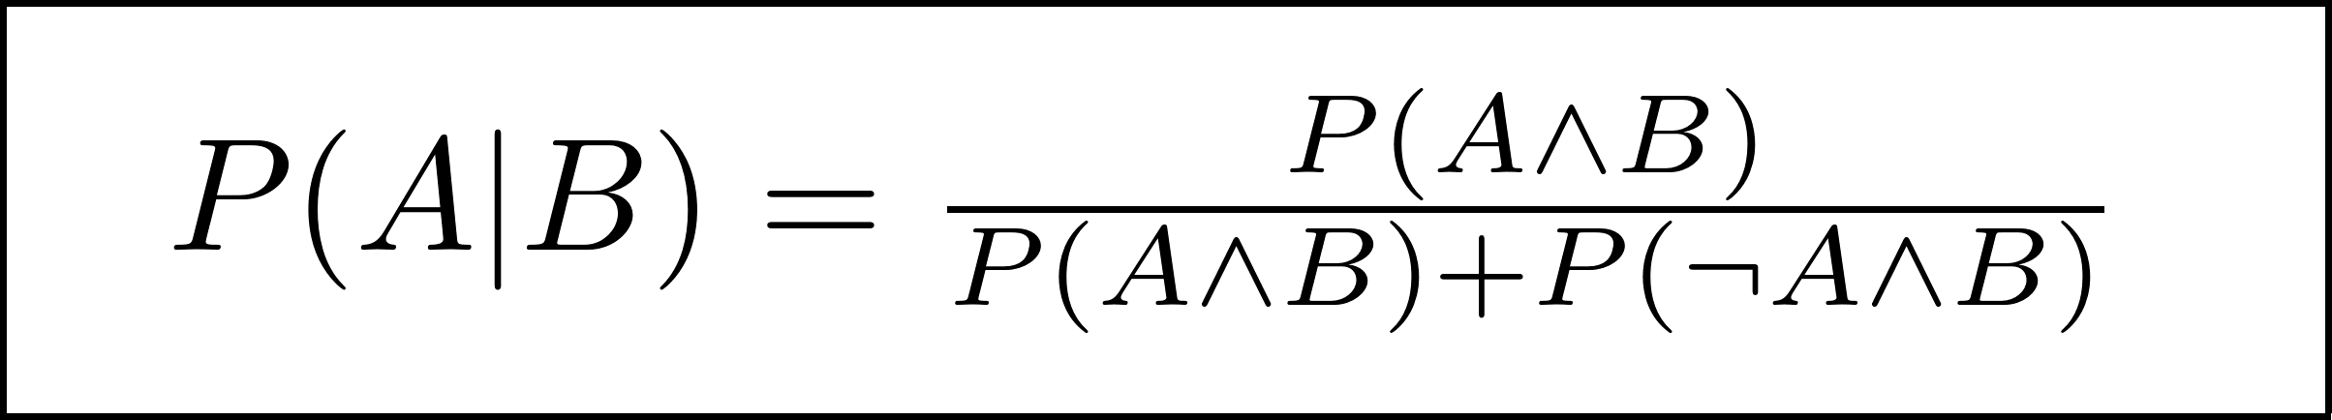
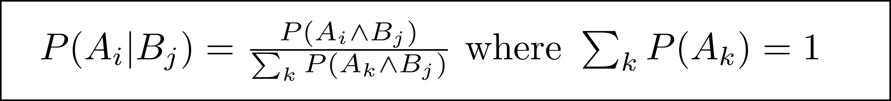
Bayes’ Rule
⇓
⇓
prime
¬ prime
odd
2/6
1/6
3/6
¬odd
1/6
2/6
3/6
3/6
3/6
Easier formulation:
Generalization to categorical events/features:

Slide 19
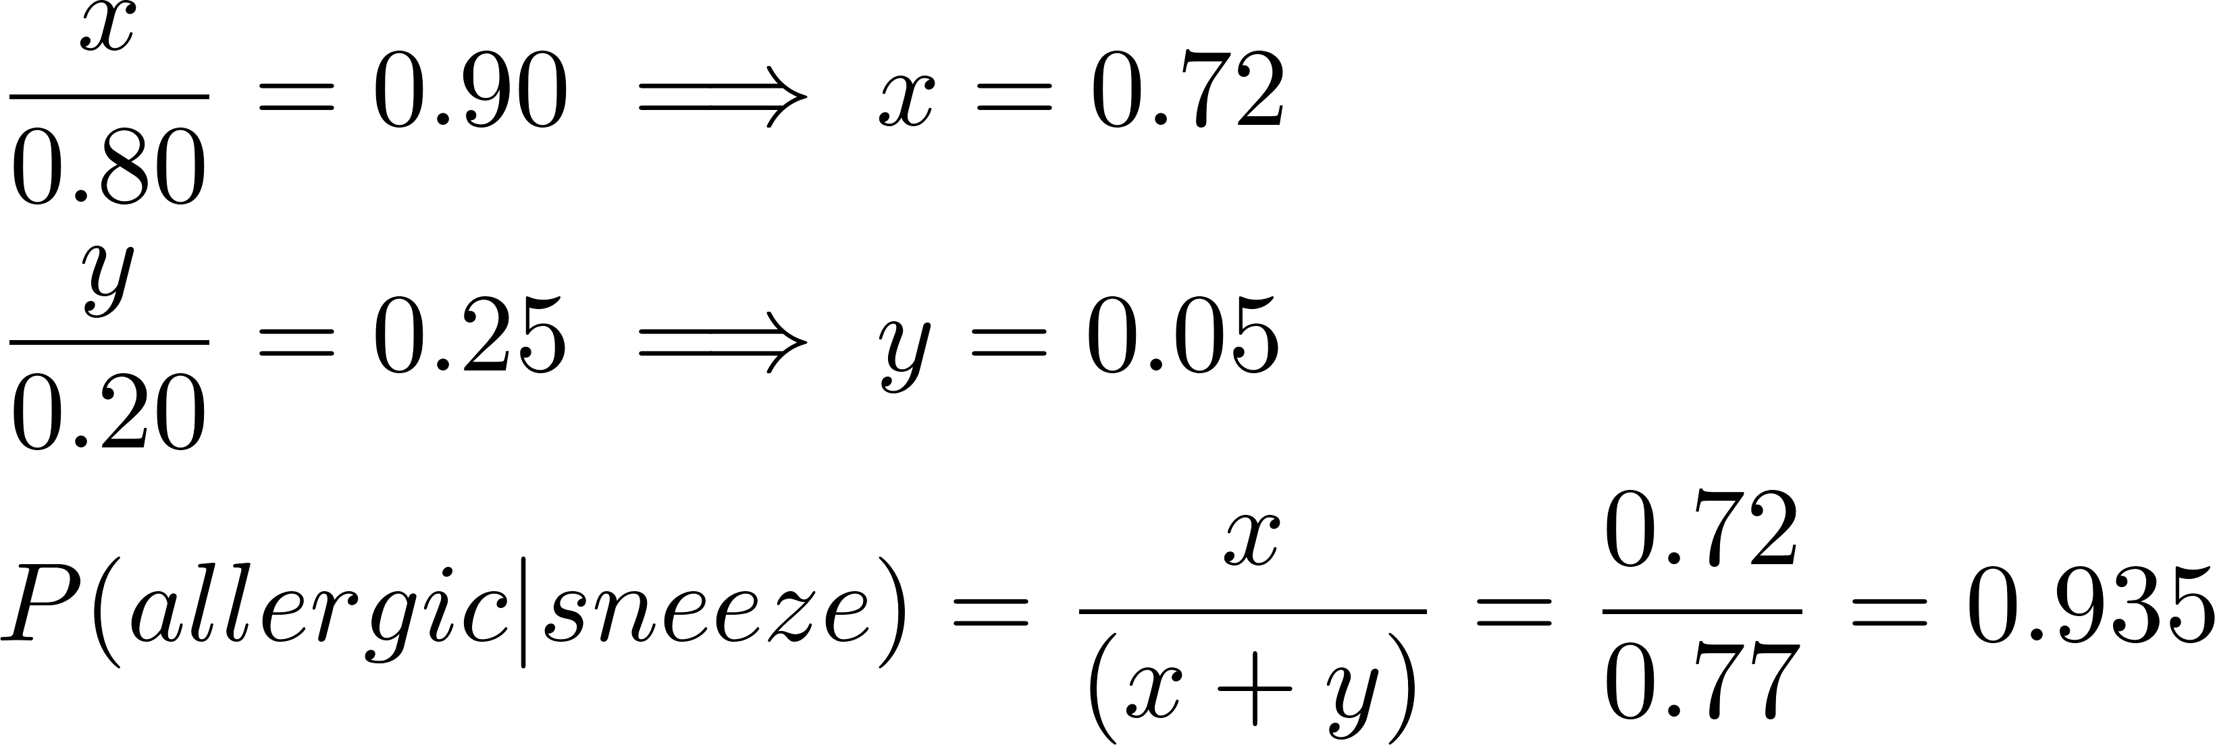
Bayes’ rule: classical example
sneeze
¬ sneeze
80% of people are allergic to cats.
90% of people with cat allergies sneeze if a cat enters the room.
Only 25% of people without cat allergies would sneeze.
A cat enters the room and I sneeze.
What is the probability that I am allergic to cats?
allergic
x
(0.80-x)
0.80
¬allergic
y
(0.20-y)
0.20
Prior = 80%, posterior = 93.5%
Evidence increases probability I am allergic to cats.
What if 90% of people without cat allergies would sneeze?
Show that posterior = prior since intuitively, event is irrelevant.

Slide 20
Applications of
Bayes’ Rule

Slide 21
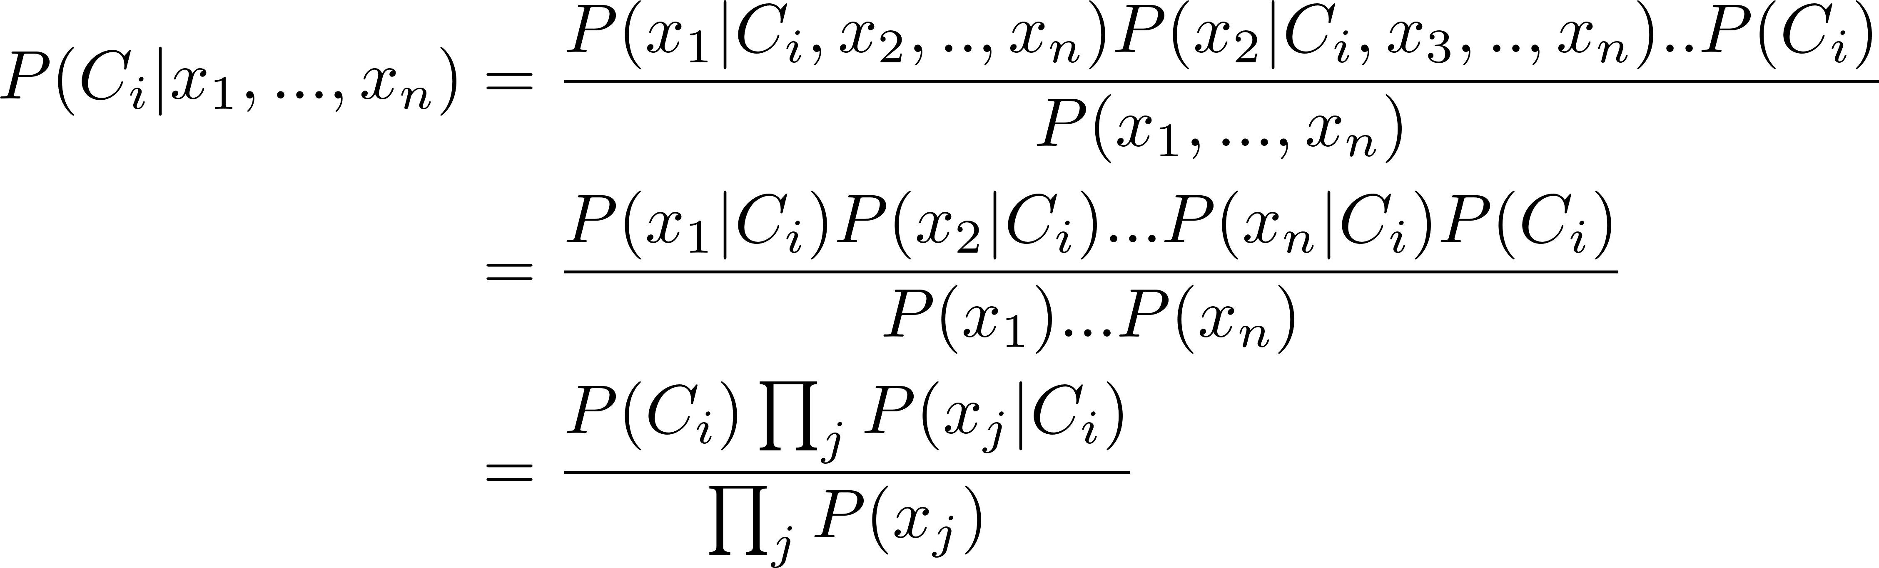
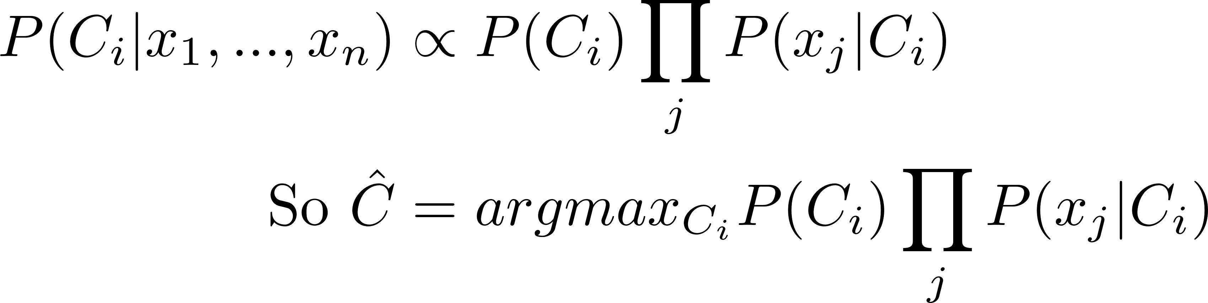
Naïve Bayes Classifier
Training data:
set of classes C₁, C₂,…,C_{m}
set of objects with features X₁,X₂,..X_{n} and a class label
Inference: given features (x₁,…,x_{n}) of object, predict class
Key assumption:
Feature independence: Each feature does not affect any other feature.
Called Maximum a Posteriori Estimator (MAPE)
Difference from Maximum Likelihood Estimator: multiplication with prior
Denominator is independent of the class so
Maximum Likelihood Estimator
P(C_{i}) can be set to 1/m or computed from training data
Righthand side is usually computed using log probabilities
to minimize underflows

Slide 22
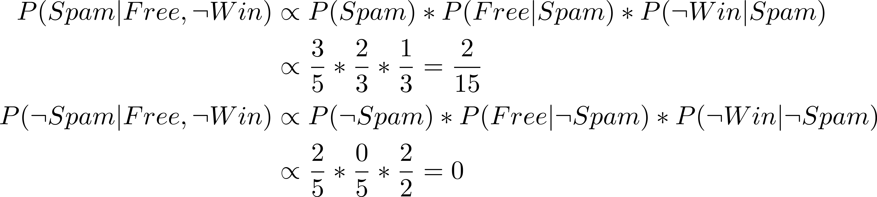
Naïve Bayes Classifier: example
Training data:
Email | Contains “Free”? | Contains “Win”? | Class
1 | Yes | Yes | Spam
2 | Yes | No | Spam
3 | No | Yes | Spam
4 | No | No | Not Spam
5 | No | No | Not Spam
Prediction: Spam
Inference: Given mail with “Free” but not win, is it spam?
Drawback of naïve Bayes: if some feature value does not occur in training data,
such as “Free” in messages that are not Spam, model overfits and does not generalize well.
In this example, every message with “Free” in it is classified as Spam.

Slide 23

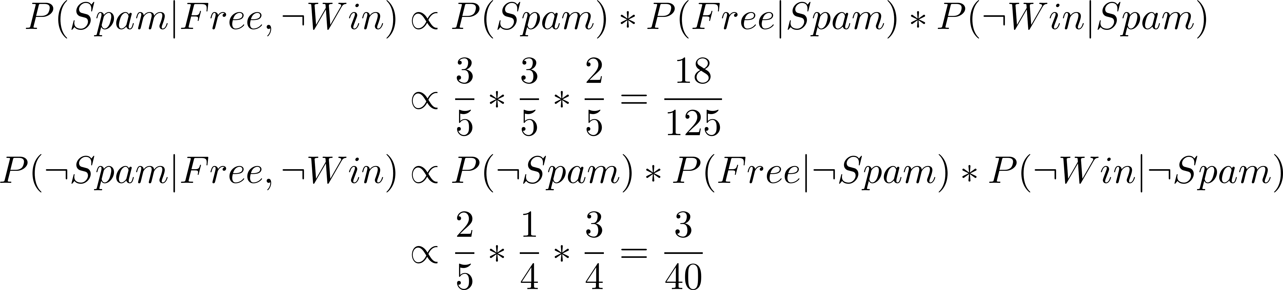
Naïve Bayes Classifier: Laplace smoothing
Training data:
Email | Contains “Free”? | Contains “Win”? | Class
1 | Yes | Yes | Spam
2 | Yes | No | Spam
3 | No | Yes | Spam
4 | No | No | Not Spam
5 | No | No | Not Spam
Laplace smoothing with strength 1
Hyperparameter “strength” k
Sample size N, outcome x, |X| possible values
P_{MAP} (x) = count(x)/N
P_{LAP,k}(x) = (count(x)+k) / (N+k*|X|)
Intuitively, assume you see k more instances
from each possible feature value

Slide 24
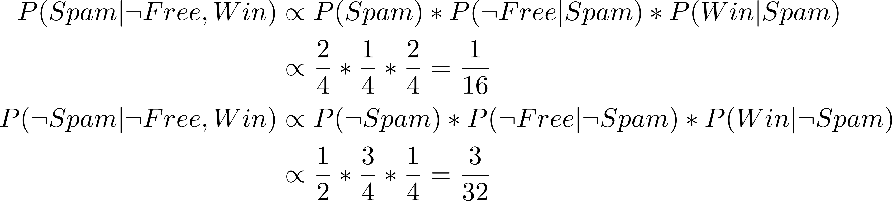
Intuition: How does naïve Bayes classifier generalize?
Training data:
Email | Contains “Free”? | Contains “Win”? | Class
1 | Yes | Yes | Spam
2 | Yes | No | Spam
3 | No | Yes | Spam
4 | No | No | Not Spam
5 | No | No | Not Spam
Prediction with Laplace smoothing (1) : ¬ Spam
Inference: Given mail with no “Free” and “Win”, is it spam?
F
W
¬ F
x
¬ W
x
Spam
Naïve Bayes classifier generalizes by computing class probabilities
for given individual features, and multiplying these probabilities
to implicitly fill in joint probability table.
2/4
1/4
x x
¬ Spam
1/4
3/4

Slide 25
Bayesian Networks

Slide 26
Conditional probability & probability tree
P(B|A)
0.90
B
P(A)
A
0.80
0.20
0.80
0.10
¬ B
P(¬B|A)
A
¬A
0.10
0.25
P(B|¬A)
B
0.25
0.90
0.75
0.20
P(¬A)
¬ A
B
¬B
0.75
¬ B
P(¬B|¬A)
Probability tree
Bayesian network: DAG with one node per event

Slide 27
Markov Chain Monte Carlo
Markov Chain Monte Carlo (MCMC)
Markov Chain Monte Carlo (MCMC) methods sample from posterior distributions when direct computation is difficult. The Metropolis-Hastings algorithm proposes new parameter values and accepts them based on their probability. Gibbs Sampling simplifies the process by sampling each part of the model sequentially. MCMC is useful for high-dimensional and complex distributions. It generates samples iteratively to approximate the posterior. These methods are commonly used in Bayesian analysis for reliable results.
Gibbs sampling

Slide 28
Variational Inference
Variational inference is a faster alternative to MCMC for approximating posterior distributions. It uses a simpler, approximate distribution instead of the true posterior. The method minimizes the difference using KL divergence. It is efficient for large datasets and high-dimensional problems. Variational inference is less computationally expensive than MCMC. However, it may sacrifice some accuracy.

Slide 29
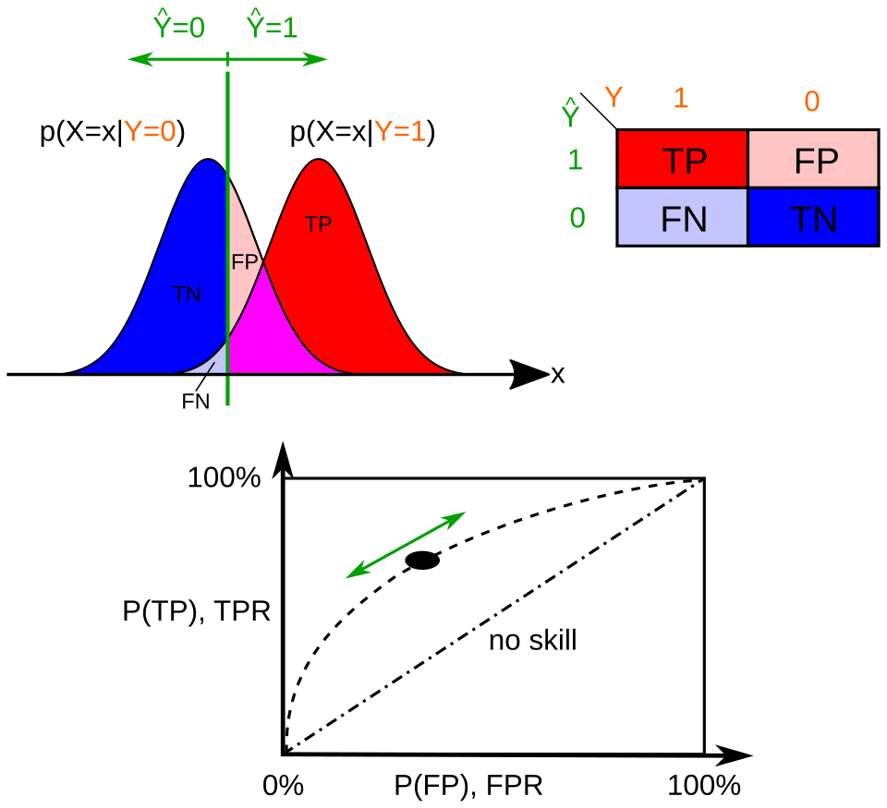
Likelihood functions, confusion matrix, and ROC curve

Slide 31
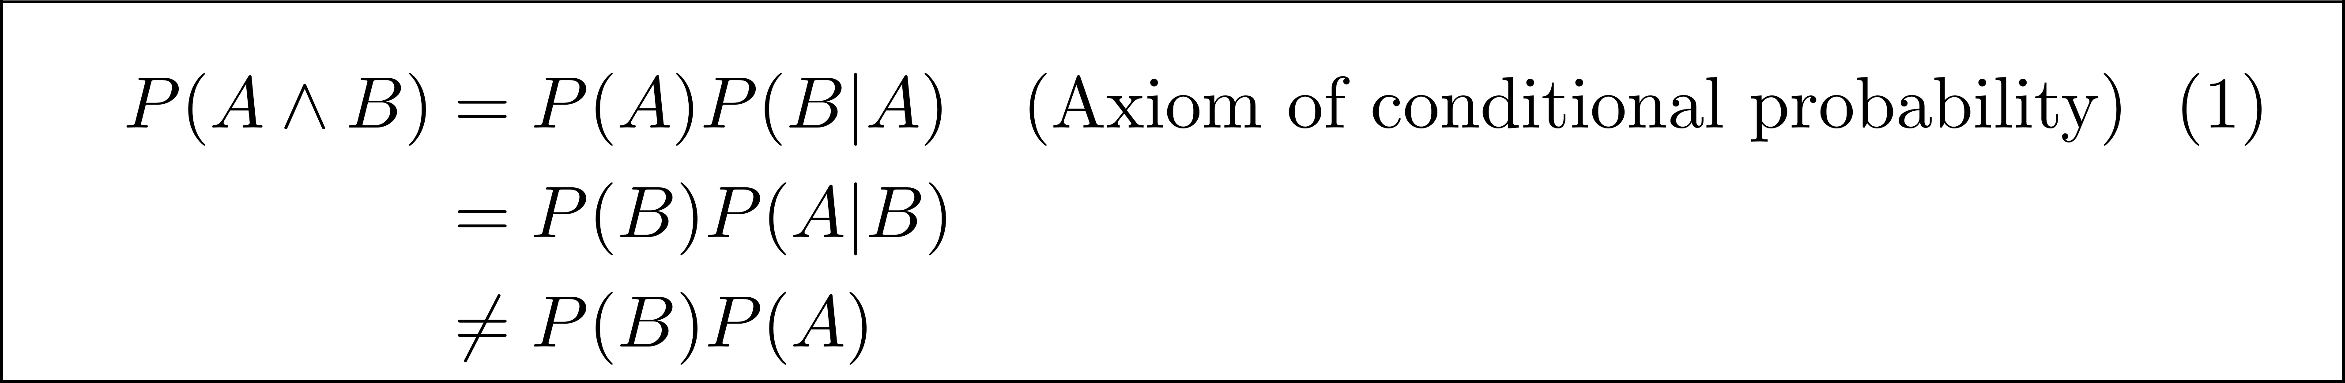
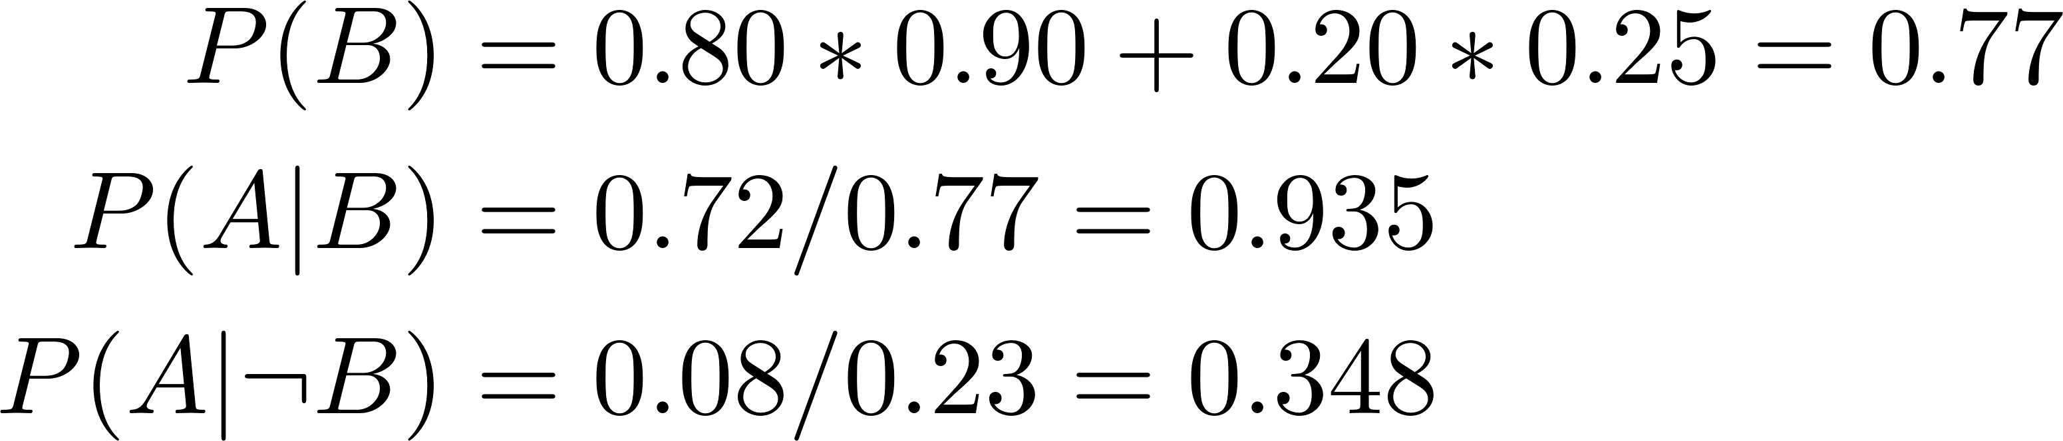
Joint probability and marginalization
P(B|A)
0.90
B
0.72
P(A)
A
A
A∧B
B
0.80
0.10
¬ B
0.08
P(¬B|A)
P(B|¬A)
B
0.05
0.25
0.20
P(¬A)
¬ A
0.75
¬ B
0.15
P(¬B|¬A)
Probability tree

Slide 32
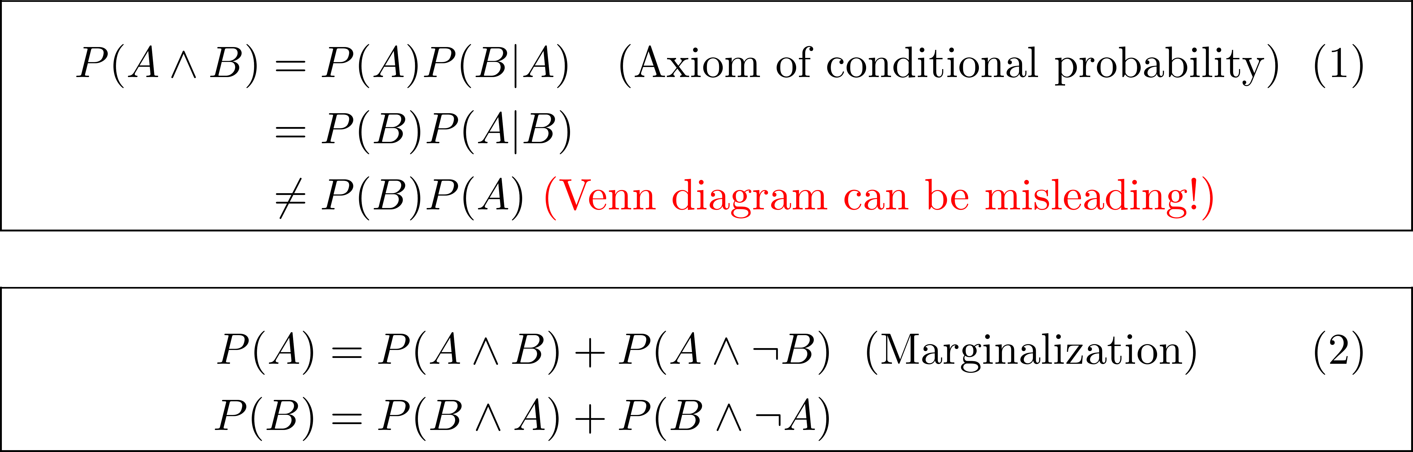
Joint probability can be subtle
What is the probability of throwing a die and obtaining a number that is odd and prime?
Ans: 1/3 since 3 and 5 are the only odd and prime numbers in {1,2,3,4,5,6}.
Wrong argument:
P(odd) = ½ {1,3,5}
P(prime) = 2/6 {3,5}
So P(odd ∧ prime) = P(odd)*P(prime) = ½ * 2/6 = 1/6
Correct argument:
P(odd) = ½ {1,3,5}
P(prime|odd) = 2/3
So P(odd ∧ prime) = ½ * 2/3 = 1/3
Point: you can multiply probabilities only if events or judgements are independent (P(A|B) = P(A))
2 4 6
odd
1 3 5
prime

Slide 33
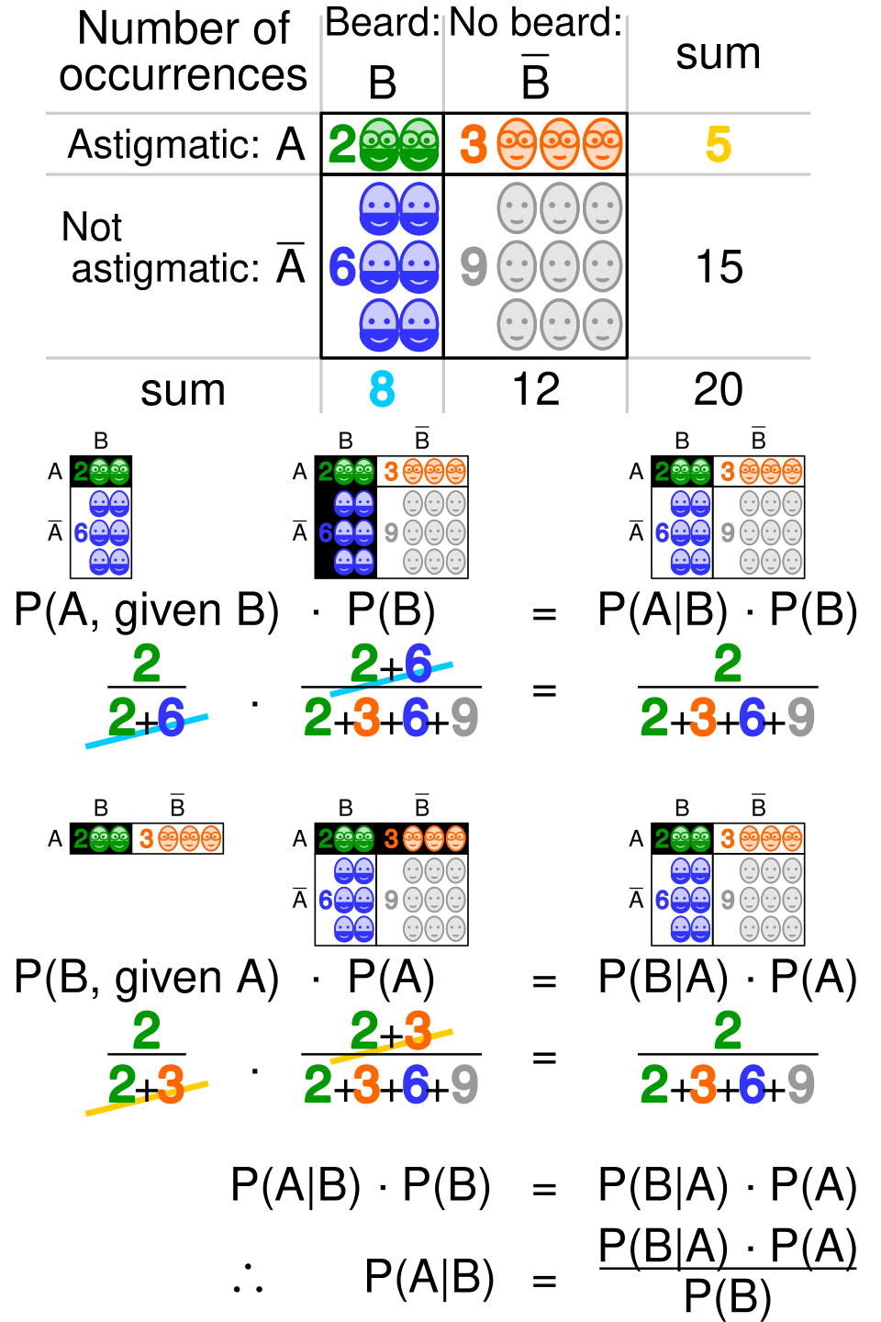
Misleading example from Wikipedia
A
A∧B
B
3
2
6
9
P(A∧B)
This example is misleading because in this case,
P(A∧B) = P(A)*P(B) !
Exercise: change values so this is not true

Slide 34
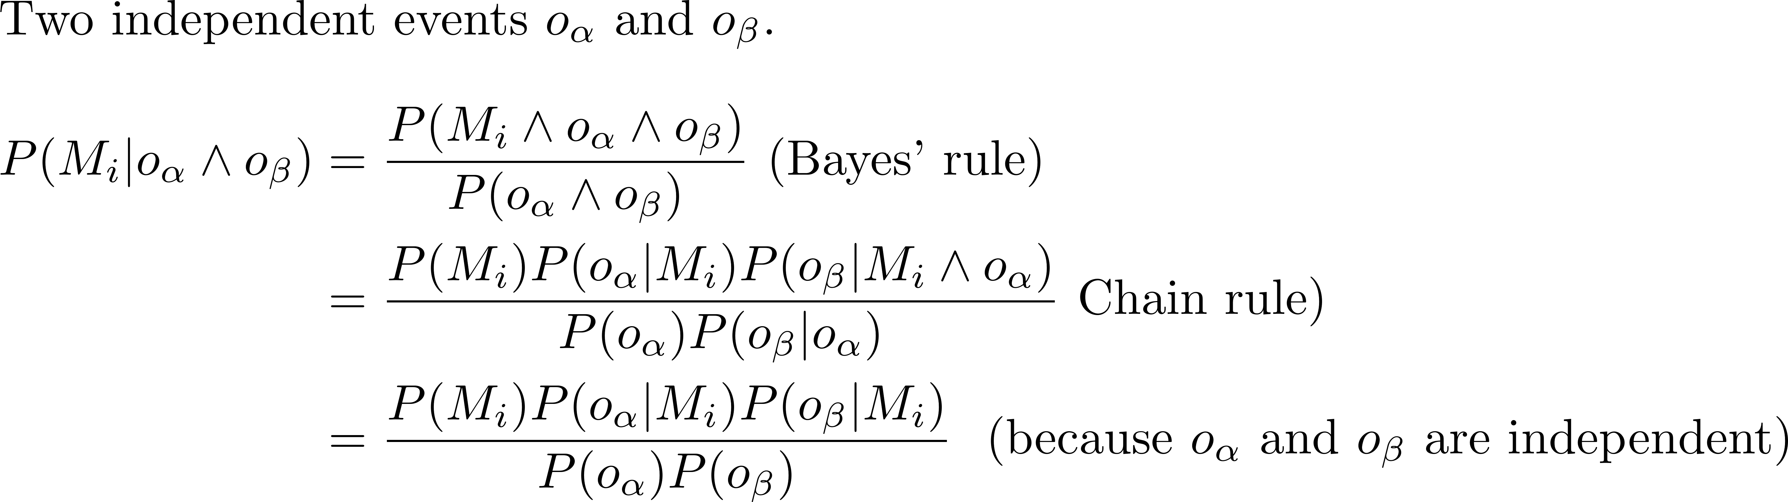
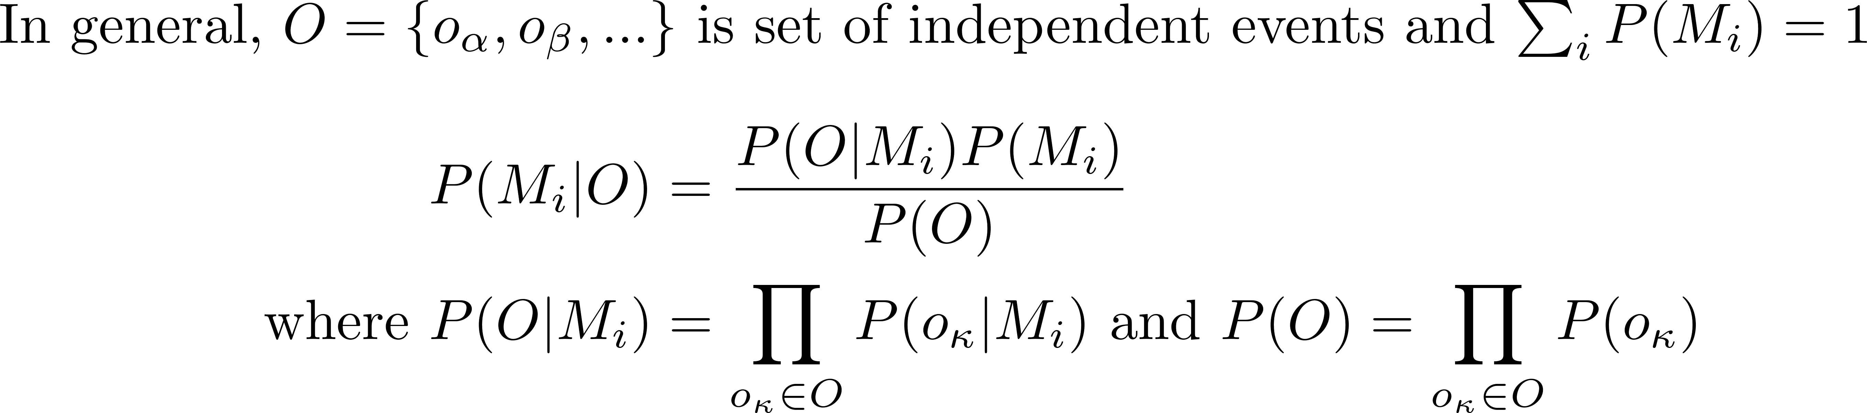
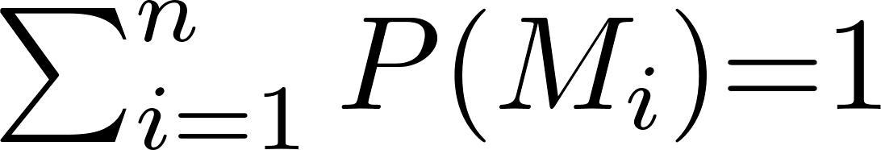
Bayes’ Rule: multiple independent events
Joint probability matrix
⇓
⇓
⇓
⇓
o1
o2
…
o_{s}
M₁
0.12
0.08
0.13
0.03
P(M₁)
⇓
M₂
…
…
…
…
P(M₂)
…
…
…
…
…
…
M_{n}
…
…
…
…
P(M_{n})

